Slide 1

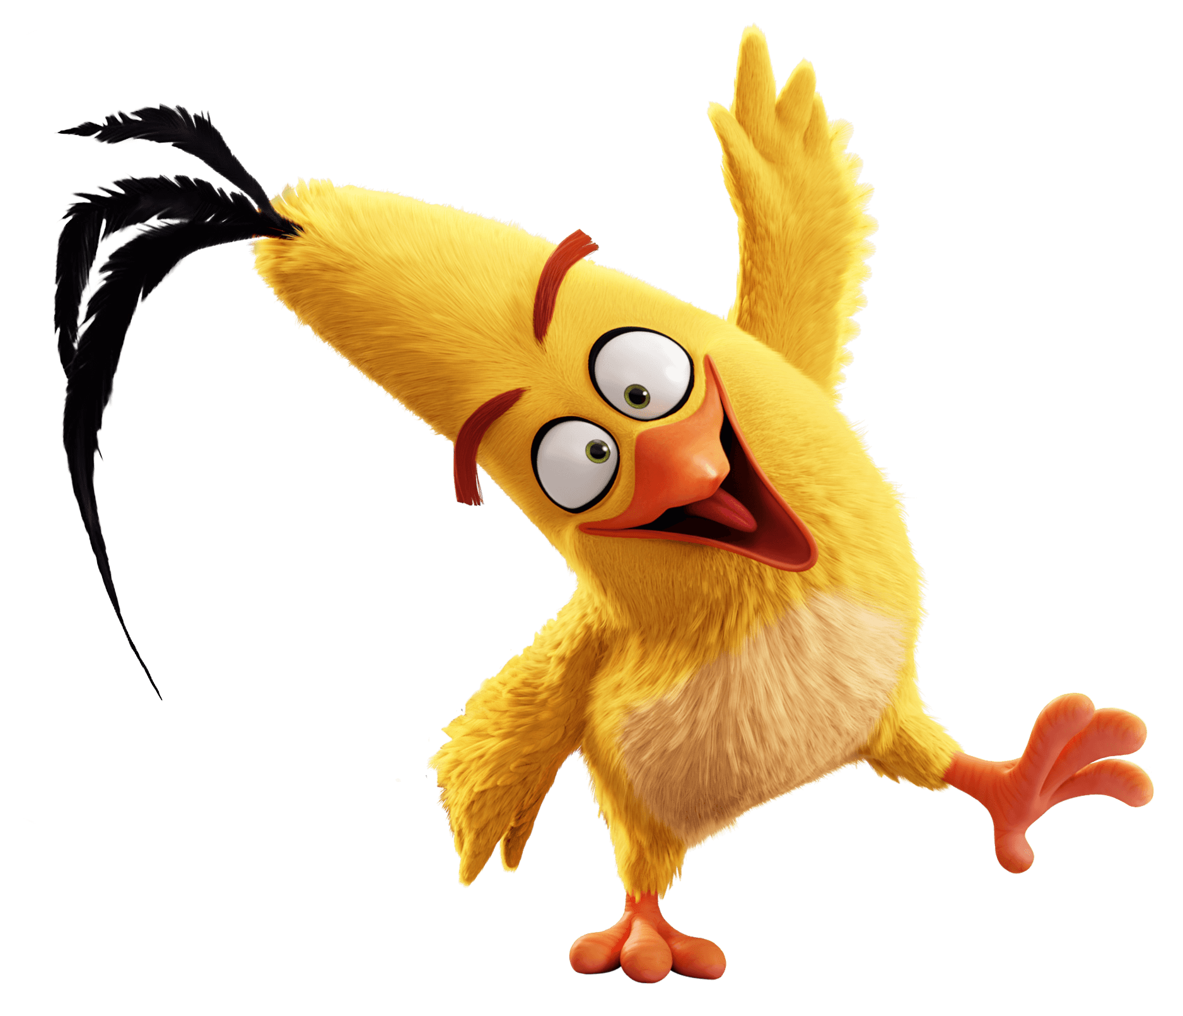
Team Name: The Brainy Fools
Flappy Bird

Slide 2
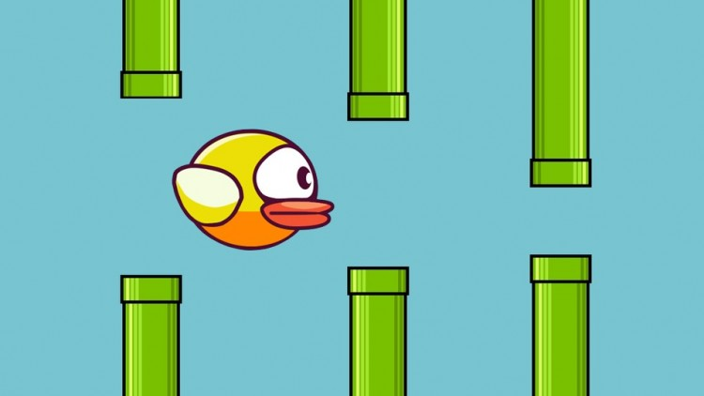
.
Project Mentor:
Falguni Roy
Lecturer
IIT,NSTU
Team Members:
1.Md Al-Adnan(ASH1825008M)
2. Moonmoon Das(ASH1825027F)
3.Akash Chandra Debnath(ASH1825037M)

Slide 3

CONTENTS
Introduction
Gameplay
Requirements
Timeline

Slide 4
Introduction
Flappy bird is a side-scroller game where the player controls a bird, attempting to fly between columns of green pipes without hitting them.
It’s a simple game of infinite level type.
It is a challenging game for anyone.

Slide 5
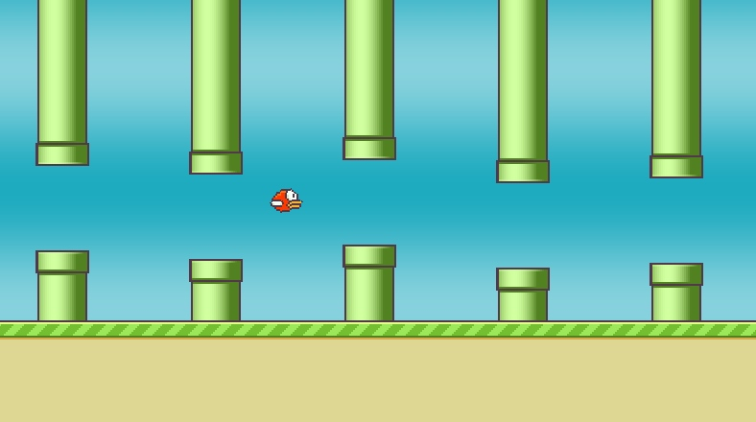
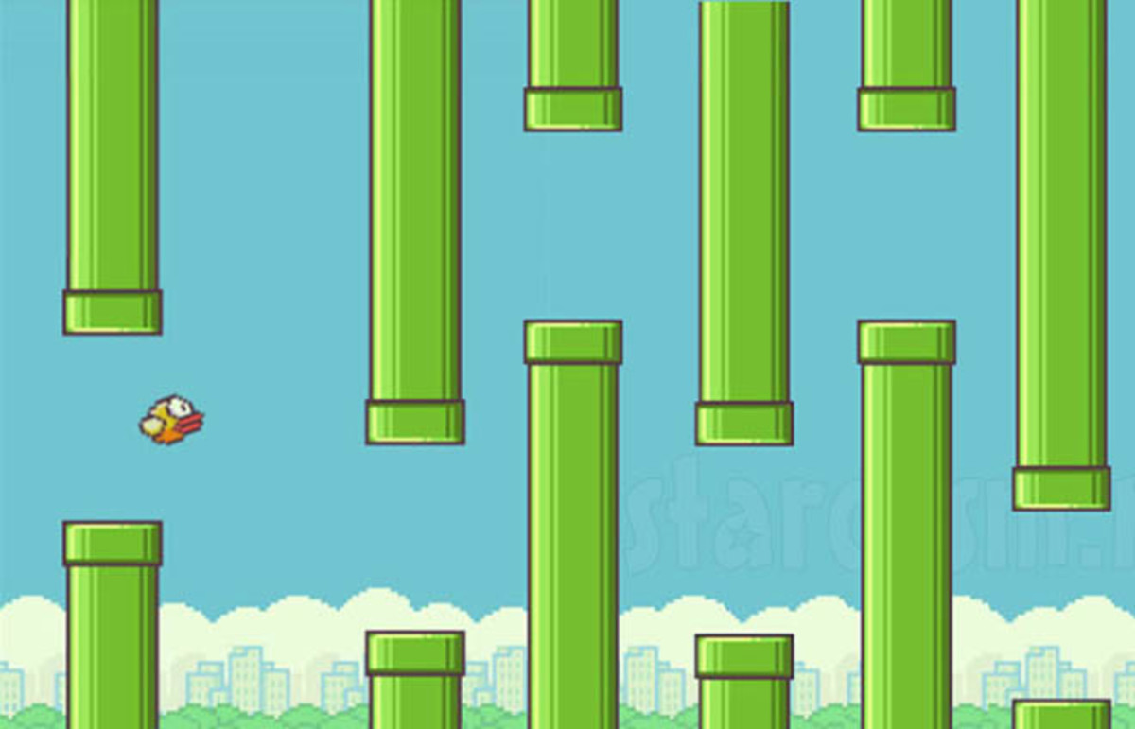

Gameplay
We plan on creating a 2D version of Flappy Bird.
The bird will be moving forward continuously between sets of pipes.
The bird jumps up a small amount whenever the spacebar is
pressed and can move to the left or right using the left and
right arrow keys.
If the bird collides with a pipe, the ground, or the ceiling,
then the game is over. The pipes will have a random size
and be created in random locations.
If any player navigates between each pair of pipes,
the player earn a single point.
Player score will be tracked throughout the level.

Slide 6
REQUIREMENTS
2D Animation
Objective Selection
Moving Wall
Collision Detection
Score Counting
Completed

Slide 7
2D Animation(Con…)
Jpanel: JPanel is a subclass of Jcomponent and Jcomponent is the subclass of Container.
BufferedImage: A buffered image is made of color model of image data. It objects have an upperleft corner co-ordinator(0,0). Image is generic but bufferedImage is the concrete implementation of the generic concept.
ImageIO: The main package of the java image I/O API.

Slide 8
2D Animation(Con…)
PrintStackTrace : It helps to find out where the problem occurred.
Paint : A Graphics context provides the capabilities of drawing on the screen.
Repaint : Repaint is invoked by a program to drawing. To call paint() manually then repaint() is used.
ActionListener : It is a interface that contains a single method, public void(ActionEvent e).
Rendering : To display text, shapes or images in the graphics 2D rendering context and then call one of the rendering methods , such as draw or fill.

Slide 9
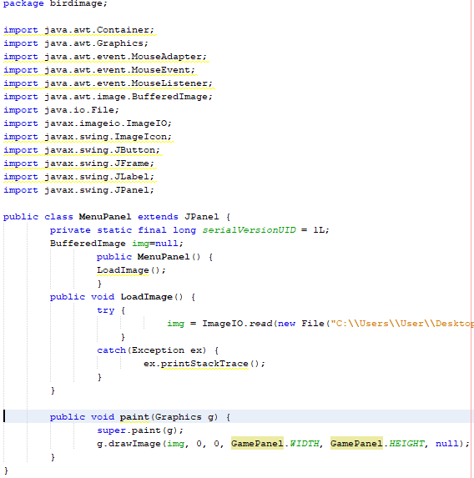
2D Animation
JPanel
Paint

Slide 10
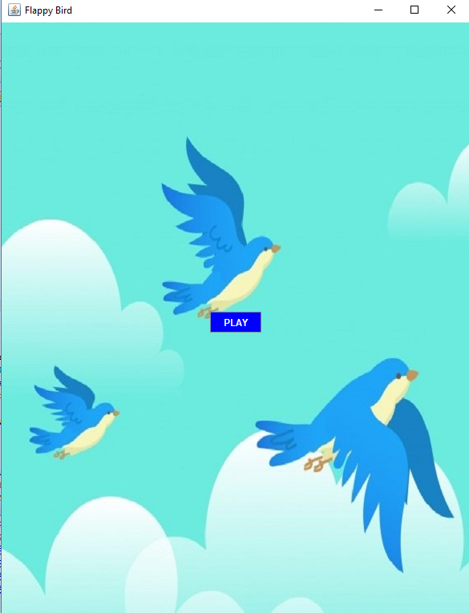
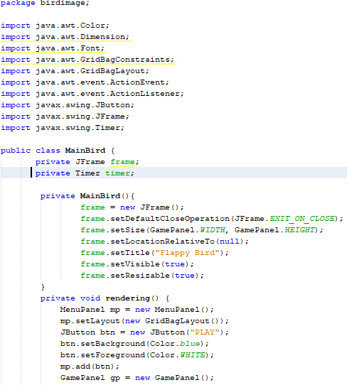
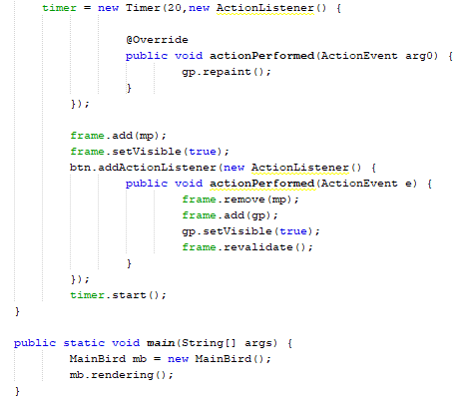
2D Animation(Con…)

Slide 11
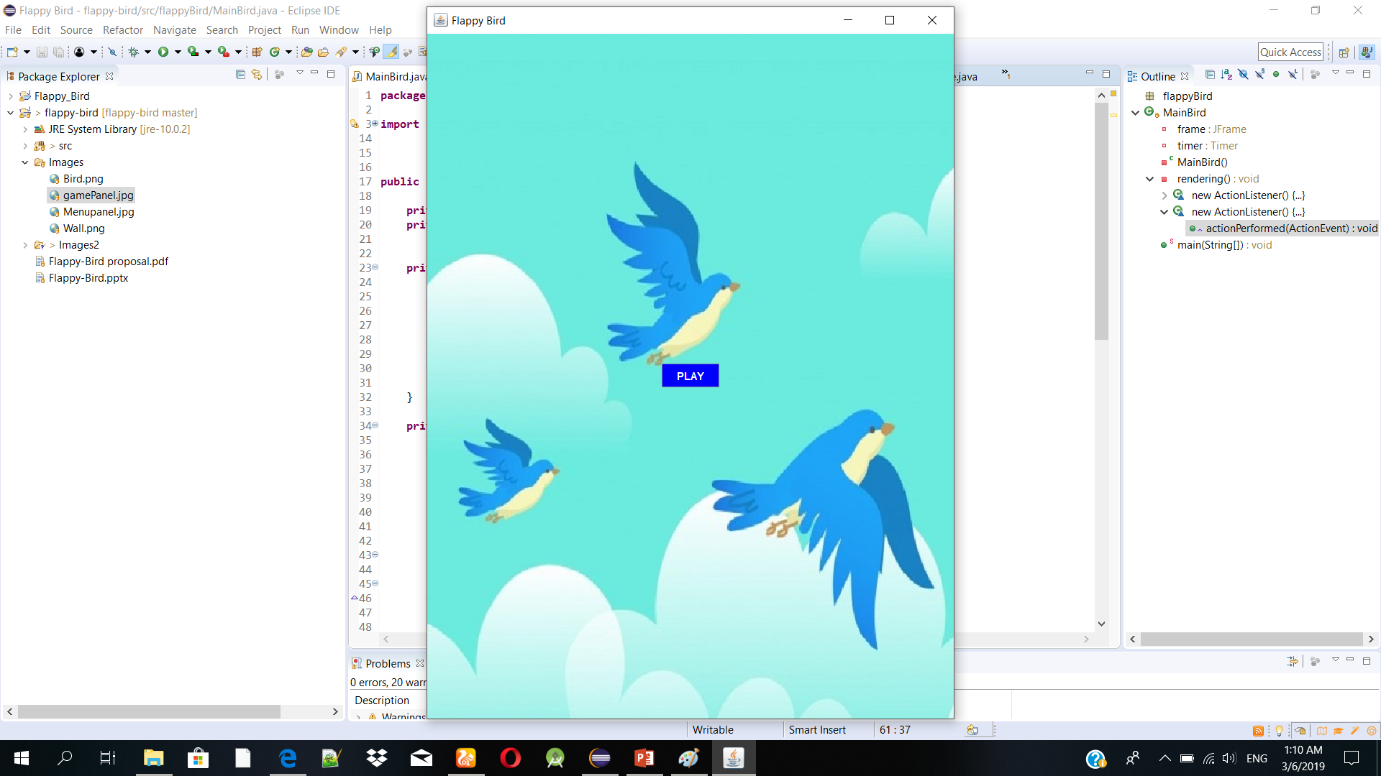
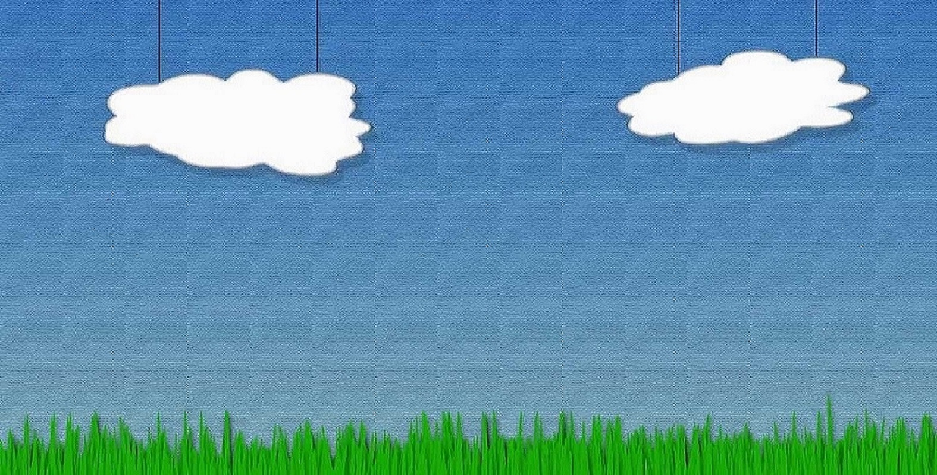
Gameplay Background
If we click PLAY button we directly go to the gameplay background

Slide 12
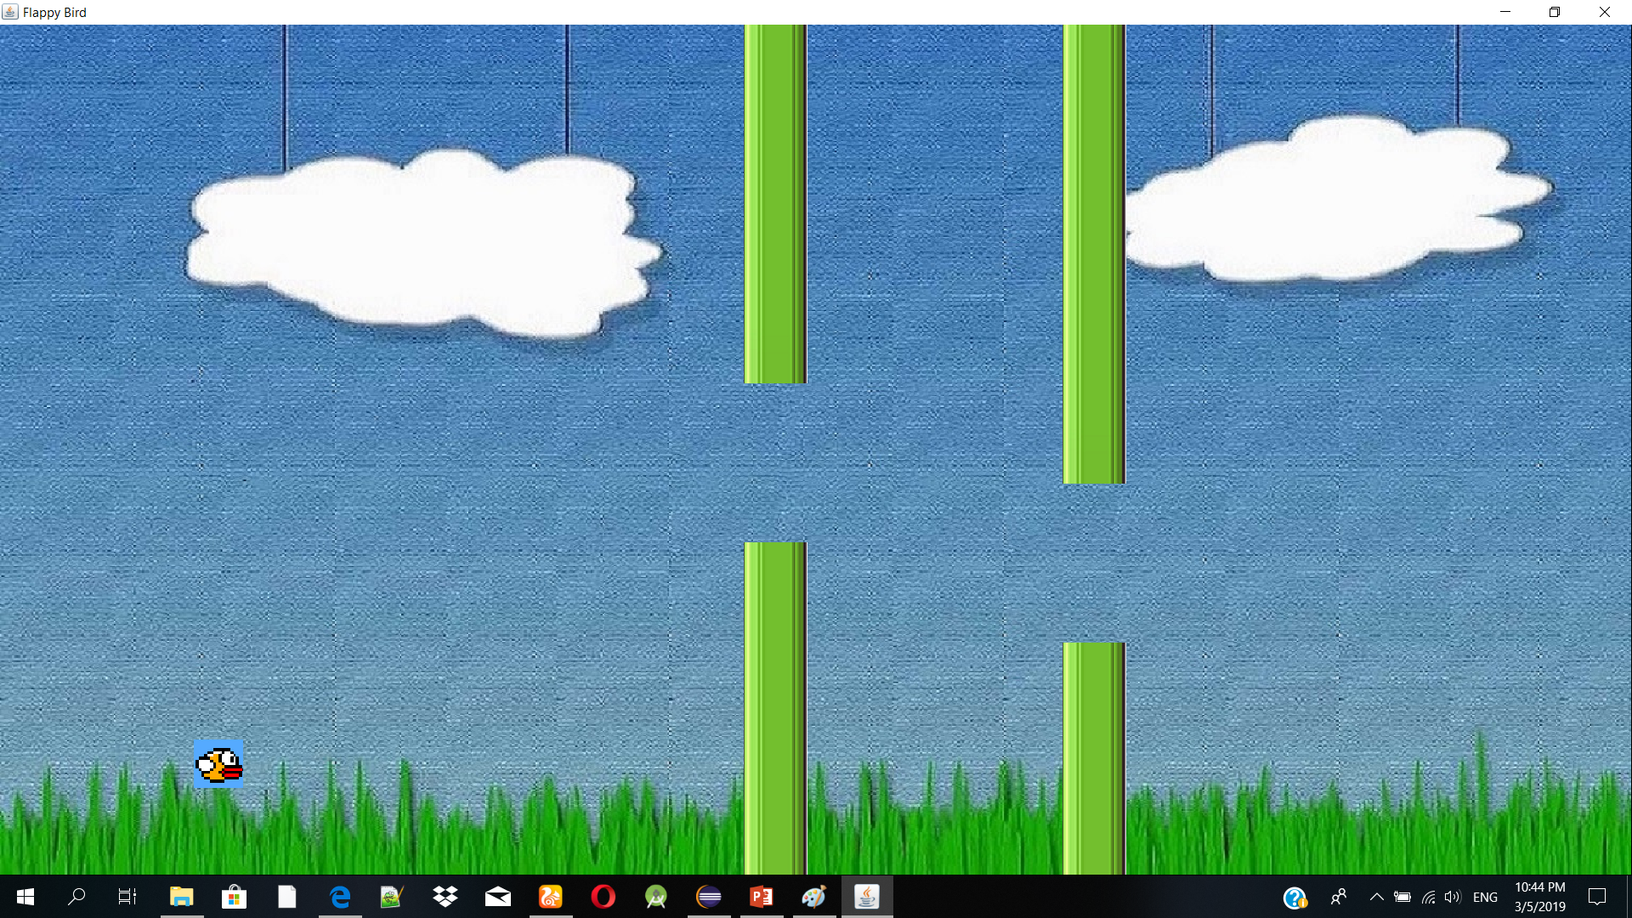
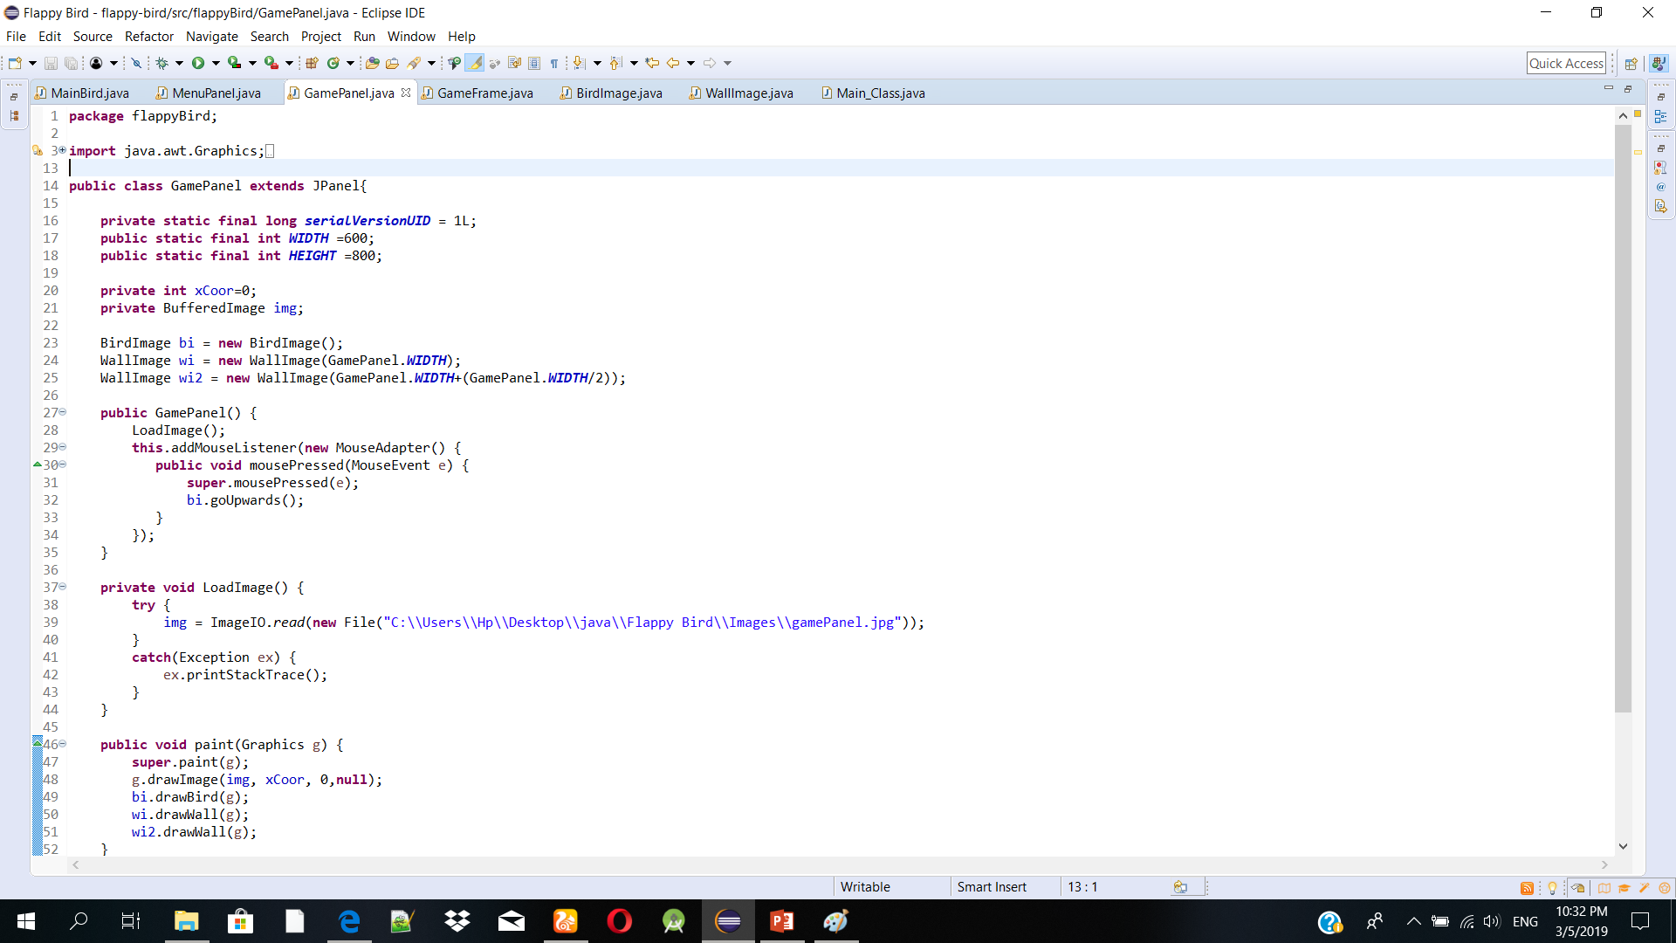
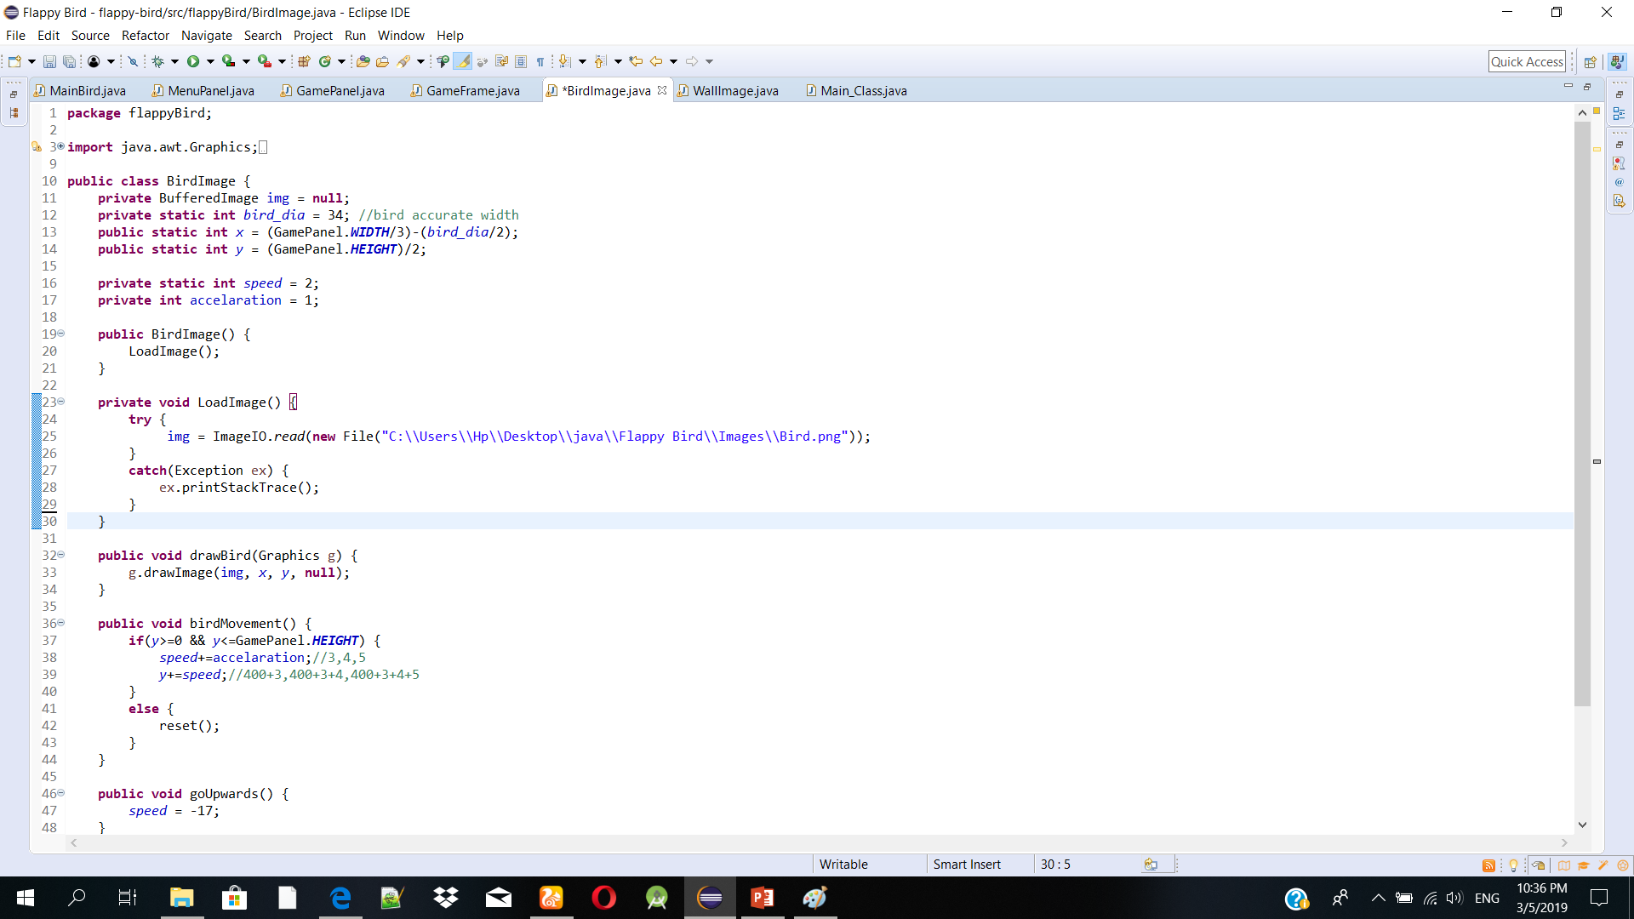

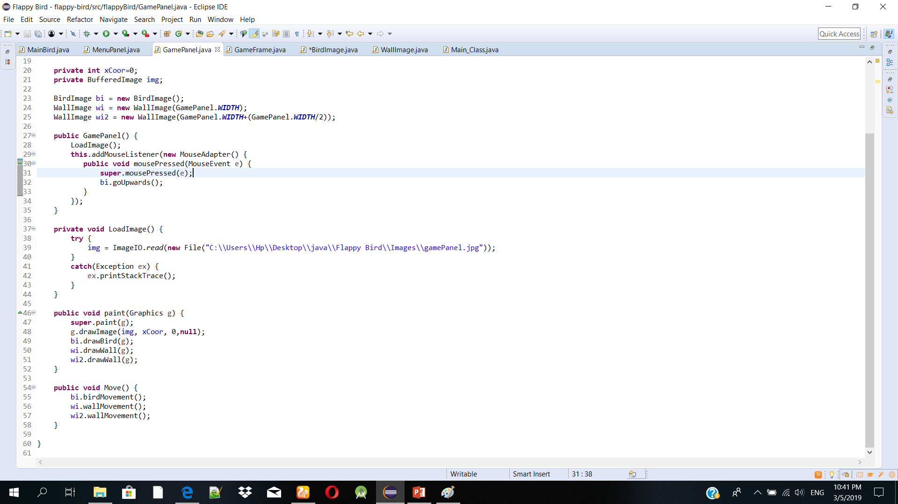
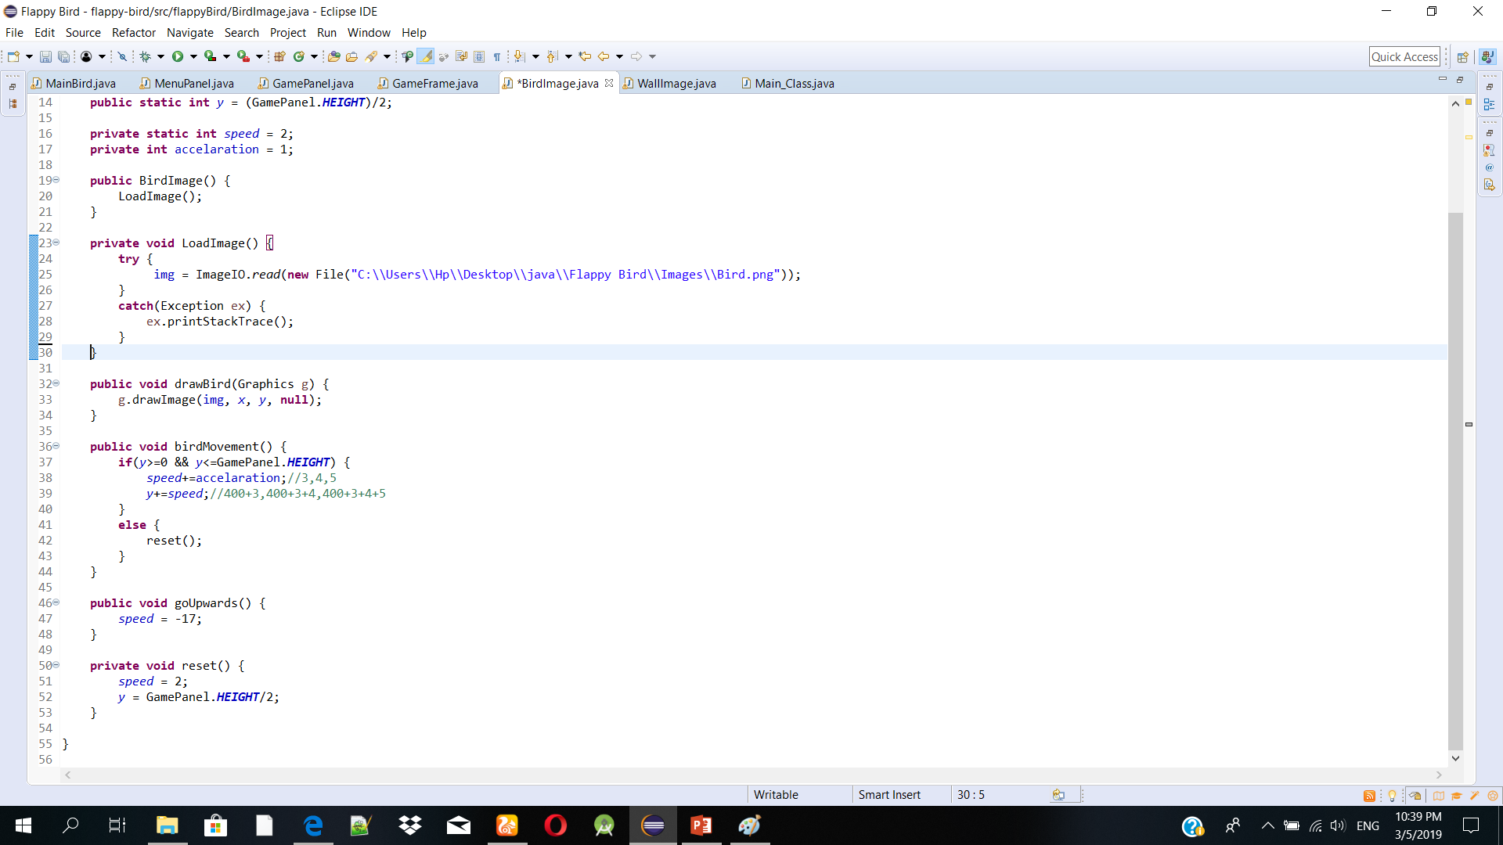
OBJECTIVE SELECTION

Slide 13
Background
600
600*3=18000
(0,0)
Birds width
(600/3)-(34/2)
=183
Window
800
800/2=400

Slide 14
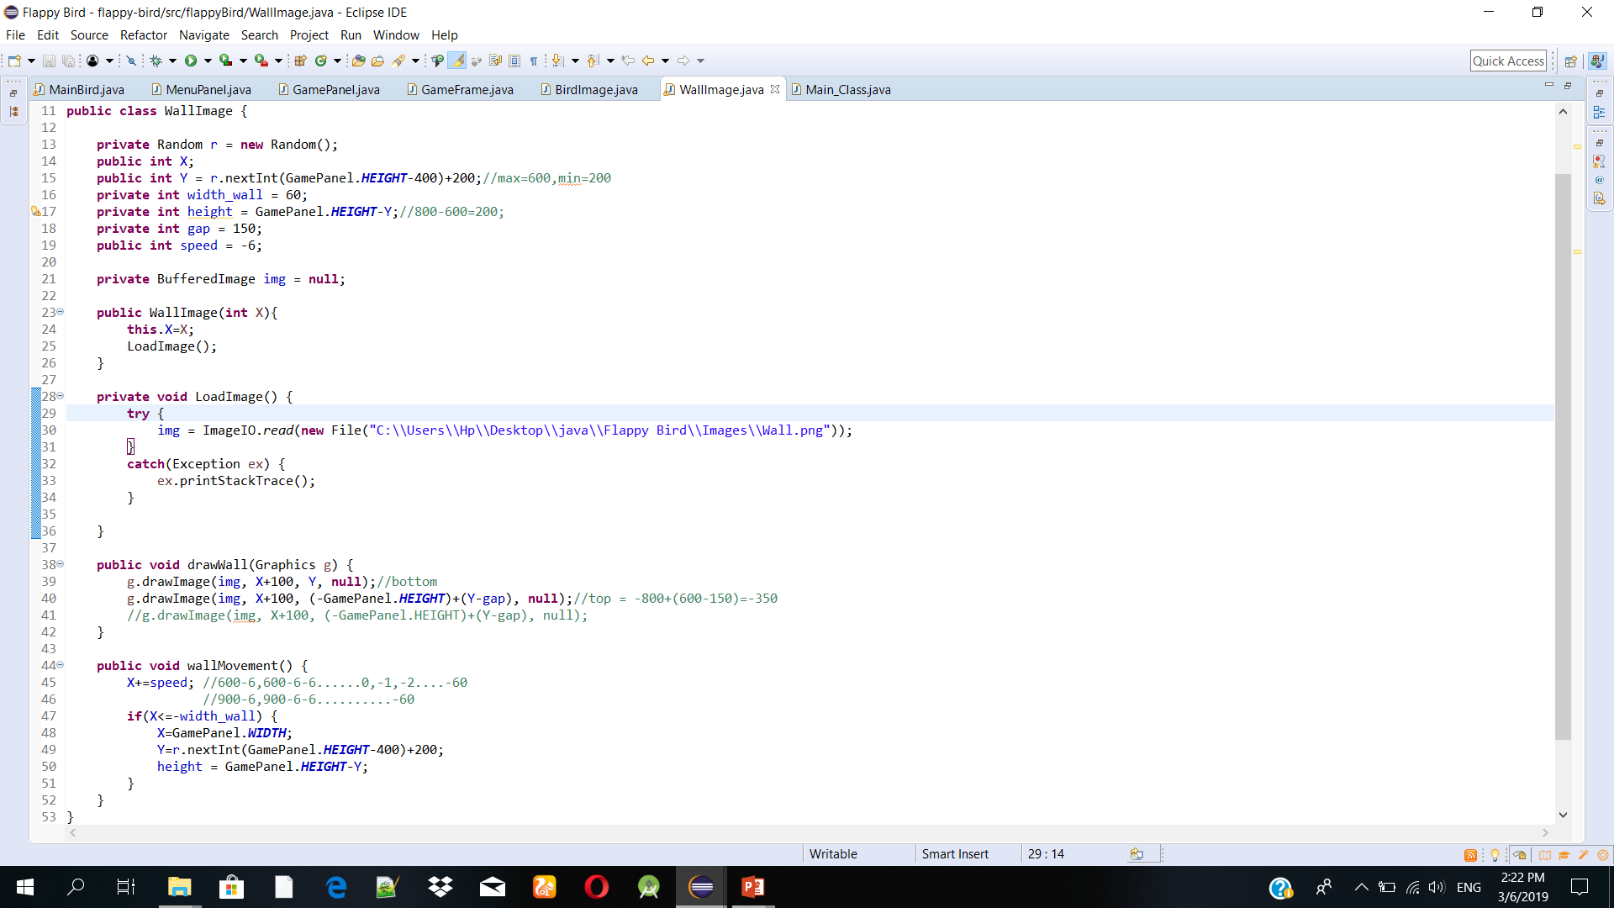
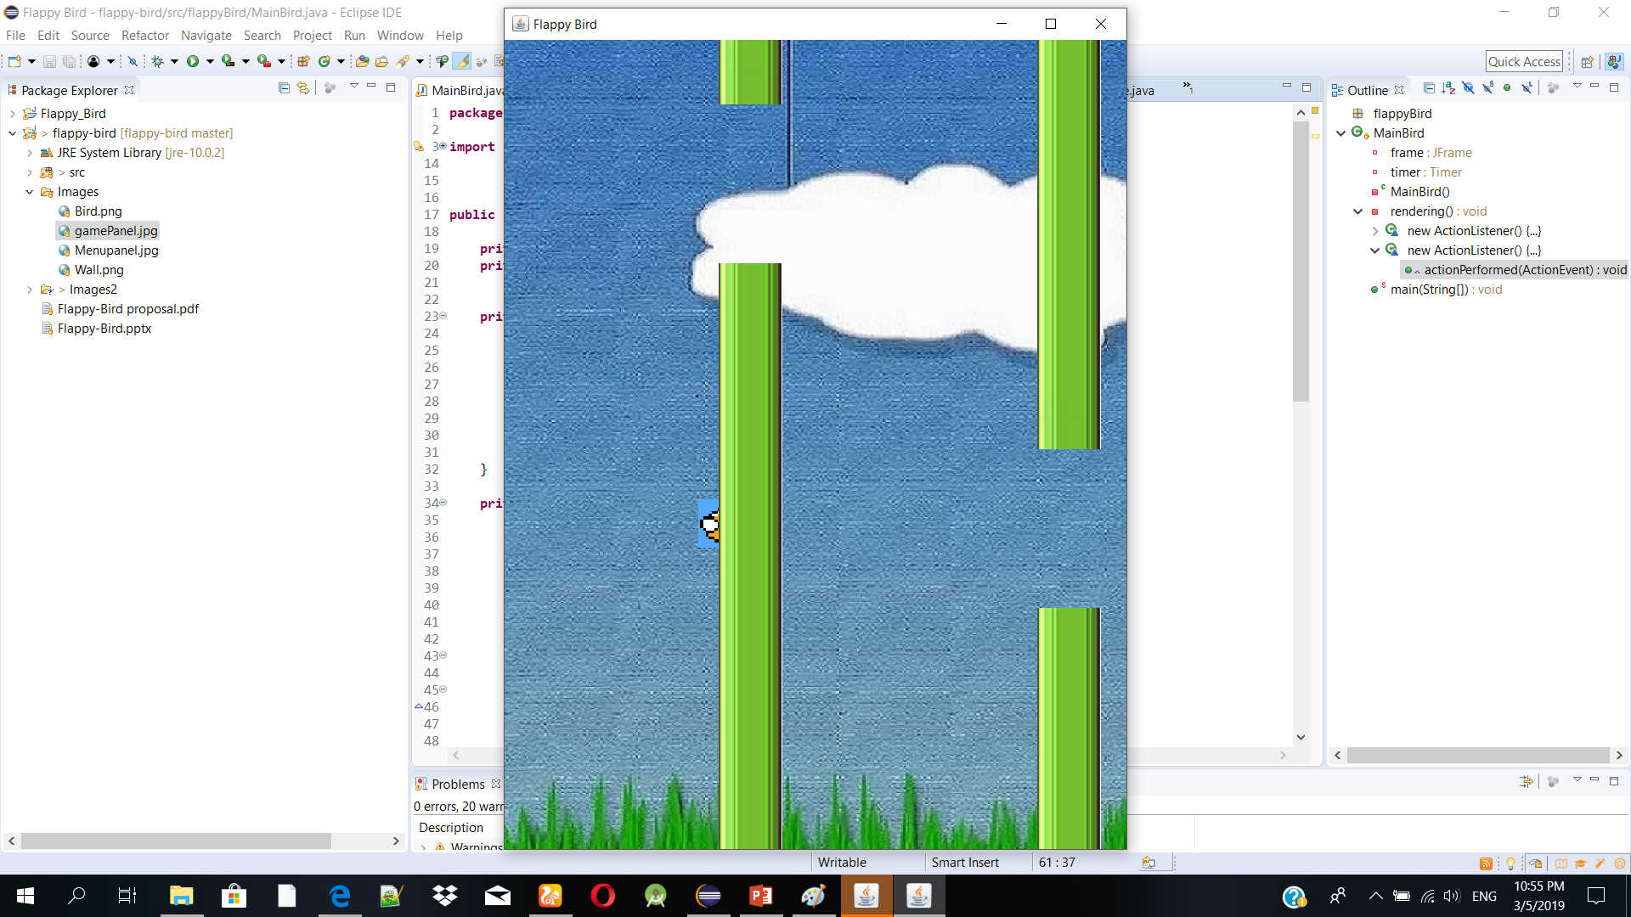
MOVING WALL

Slide 15
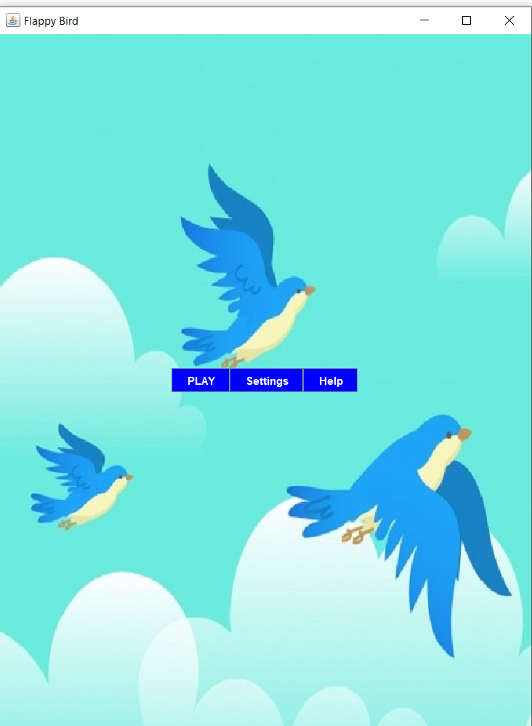
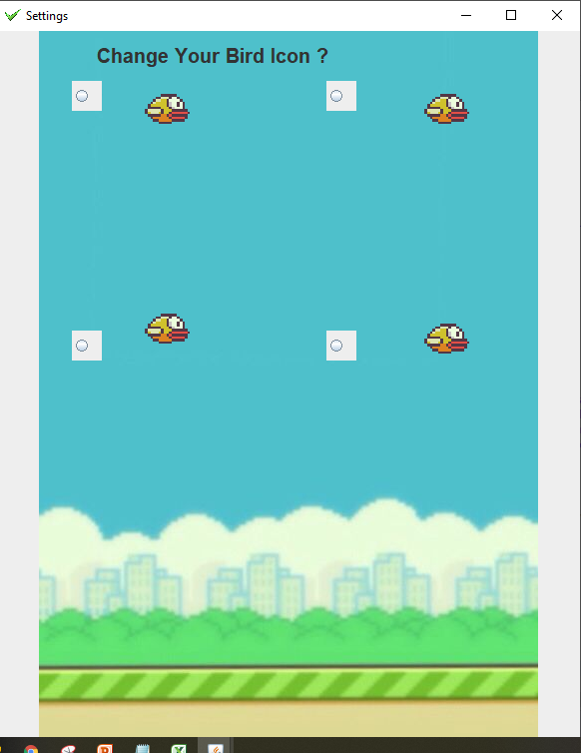
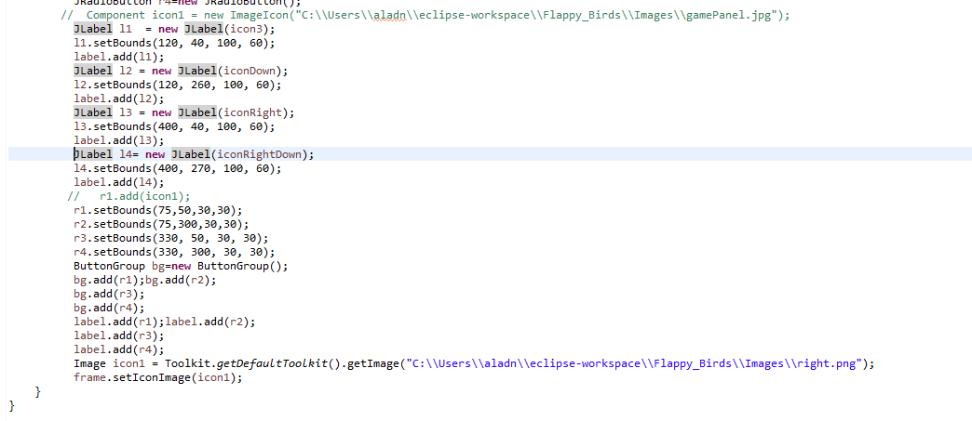
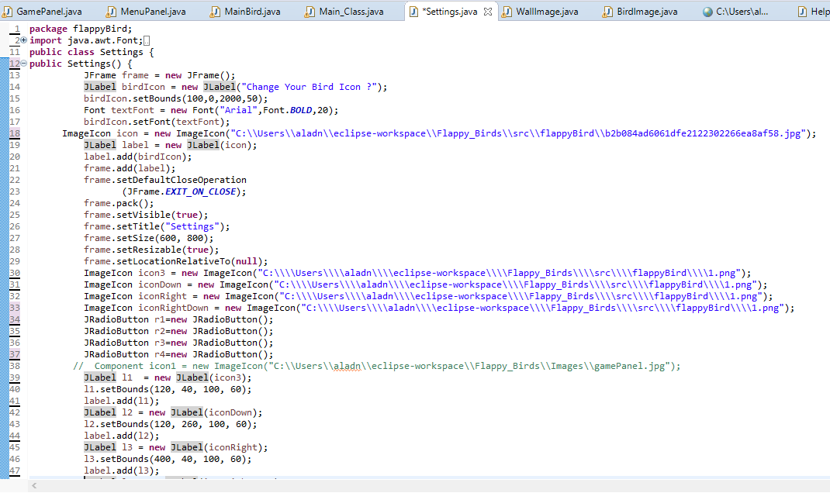
Settings

Slide 16
Timeline
Task | Deadline
Proposal | Within 3rd week of January(Completed)
Requirement Analysis, Specification | Within 20th January(Completed)
Designing, Study | Within 3rd March(Completed)
Coding | Within 10th April(Running)
Final Testing | Within 2nd May

Slide 17


